Slide 1
OBJECT PRECEPTION :LIDAR

Slide 2
OBJECT DETECTION
IT IS USED FOR CORE FUNDAMENTAL USE IN CASE OF FUNDSAMENTAL VEHICLE
OBECT DETECTION USES IN VEHICLE FOR SAFETY MANNER
USES OF OBJECT DETECTION:
NOT TO HIT THINGS
IT IS NOT TO CAUSE THE OTHER PARTICIPANTS

Slide 3
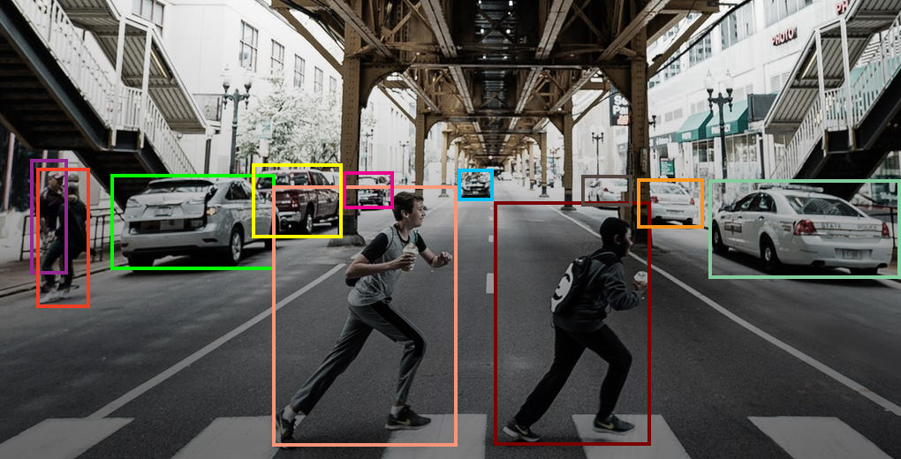

Slide 4
WAY TO PRODUCE 3D MEASUREMENTS
PLANNING REQUIRES 3D REPRESENTATION OF OBJECT
SOME EXAMPLES OF SENSING MODALITIES
LIDAR
RADAR
STEREOS CAMERA
DEPYH CAMERA

Slide 5
DETECTION STACK OF LIDAL OBJECT
A CLASSICAL STACK IS SIMPLE AND EASY TO UNDERSTAND
IT IS EASY TO CONTROL THE IMPLEMENTATION
IT IS MORE ROBUST TO ADVERISAL ATTACK

Slide 6
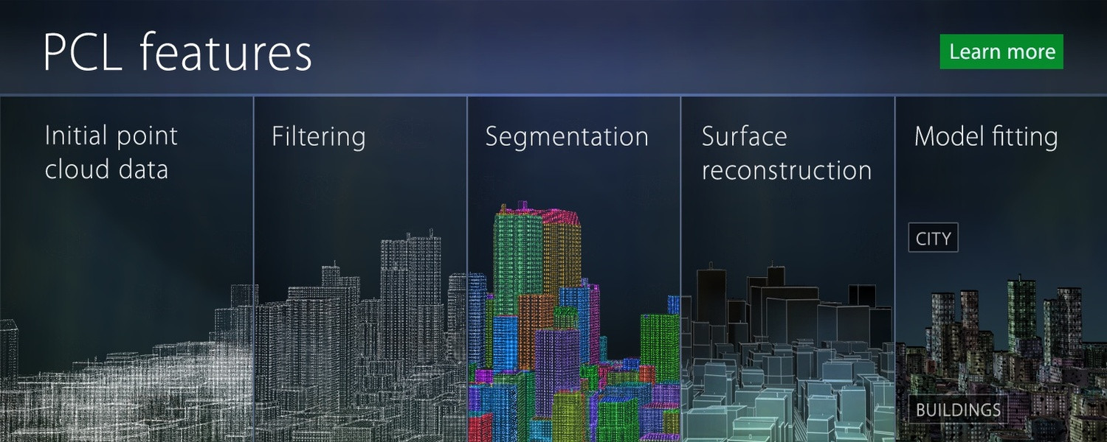
3D OBJECT DETECTION STACK

Slide 7
LIDAR PREPROCESSING
PREPROCESSING IS THE IMPORTANT PART IN THE LIDAR PROCESSING
IT PROVIDES CLEAN,SIMPLE FOR DOWNSTREAM ALGORITM
IT ACCESIBLITS NO OF DIFFERENT ALGORITM
REMOVE REDUCTANT DATA

Slide 8
GEOMETRY OBJECT DETECTION
SEGMENTATION ALGORITM IS THE IMPORTANT AND MAIN PART OF OBJECT DETECTION STACK
IT IS NEEDED TO BUILD HIGH LEVEL UNDERSTANDING OF THE WORLD
CLUSERING ALGORITM BASED ON THE REGION GROWING
VERSION IN AUTOWARE IS EUCLETDIAN CLUSTERING

Slide 9
USE CASES OF OBJECT DETECTION
ANIMAL DETECTION IN AGRICULTURE
PEOPLE DETECTION IN AGRICULTURE
VEHICLE DETECTION WITH AL IN TRANSPORT
MEDICAL FEAUTURE DETECTION IN HEALTHCARE AND SO ON

Slide 10
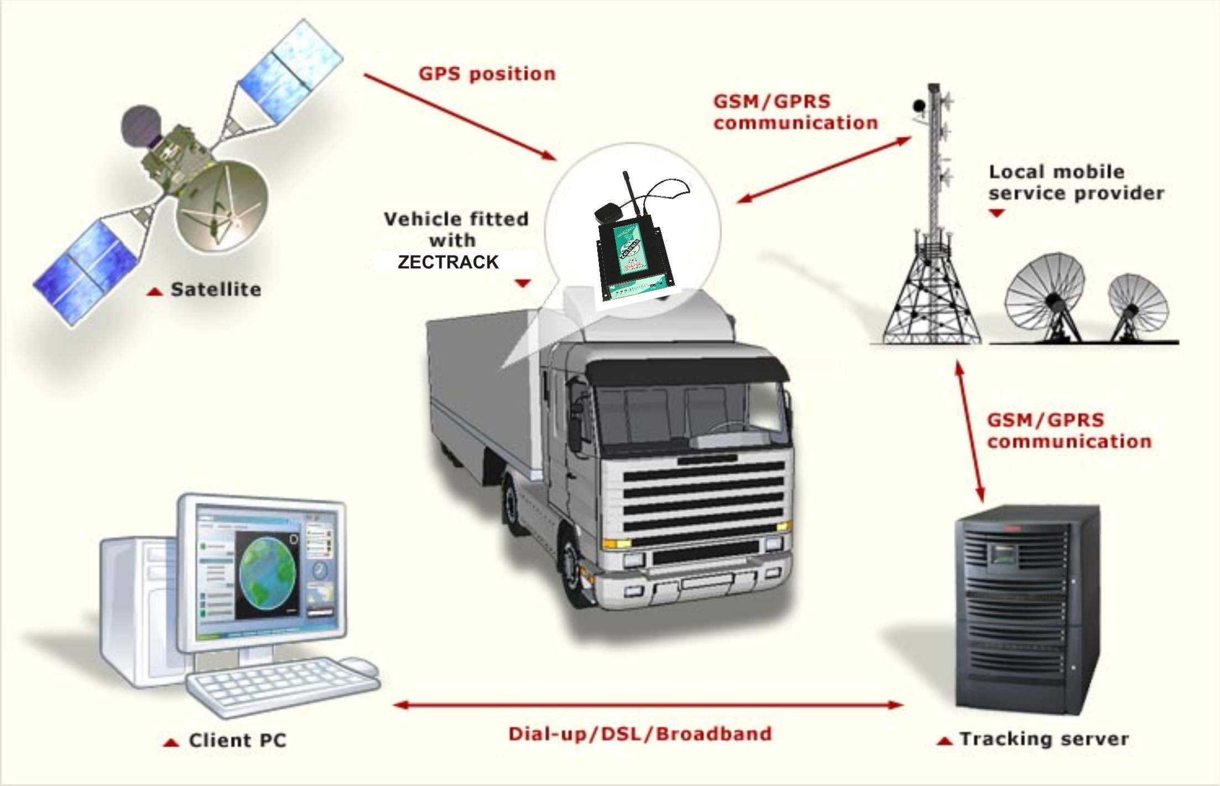
VEHICLE TRACKING SYSTEM
ONE OF THE MAIN USE CASES FOR OBJECT DETECTIVE AUTOWARE
IT CAN BE TOUGH OF AS TEMPORORLY FUSING DETECTIONS OVER TIME

